Slide 1
Report from BepiColombo/Mio Science Center
ISEE/Nagoya University
Y. Miyoshi, T. Hori, C.-W. Jun, S. Nakamura, T. Segawa
ISAS/JAXA
G. Murakami, I. Shinohara, K. Asamura, S. Aizawa
Kanazawa Univ.
S. Matsuda
Kyoto University
Y. Harada
UCB
T. Hara

Slide 2
BepiColombo/Mio Science Center
2022.04. Launch of the Mio science center (Nagoya Univ / JAXA)
In this presentation:
- Concept of the Mio Science Center
- Pipeline process of the Mio Science Data
- Data handling schedule
- Example of L2pre CDF file
- SUSANOO data archive

Slide 3
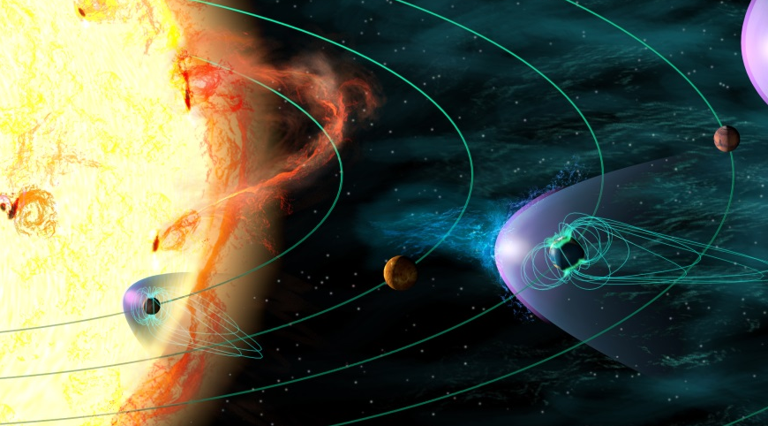
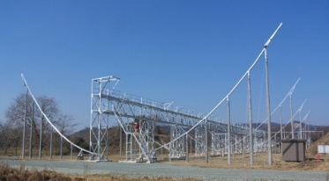
Cycle 25 Heliospheric System Observatory(HSO)
Mars
MMX
0.9 Rs: PSP
Solar-C_EVUST
IPS (25Rs)
PhoENiX
Hinode
GEO-X
Akatsuki
SMILE
1 AU
Arase
0.28 AU: SolarOrbitor
0.3 AU
BepiColombo: MPO/Mio
Geotail
5 AU
JUICE
Fleet of Heliospheric Satellite/Ground-based observations.

Slide 4
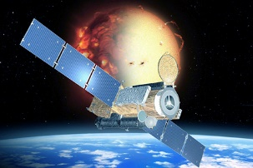

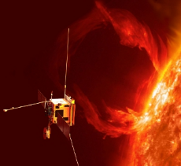
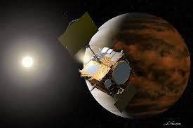
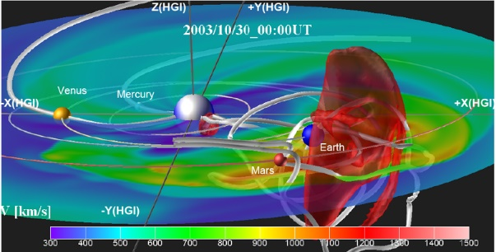
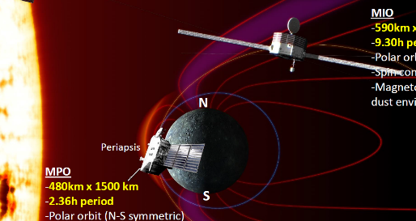
Framework for Heliospheric System Science
Fleet of satellites
Ground-network observations
Solar Orbiter
International
Heliosphere System Science
Credit: ESA/AOES
Computer Simulations
Standard data file format / Integrated data analysis software
are essential for seamless data analysis using different data set.

Slide 5
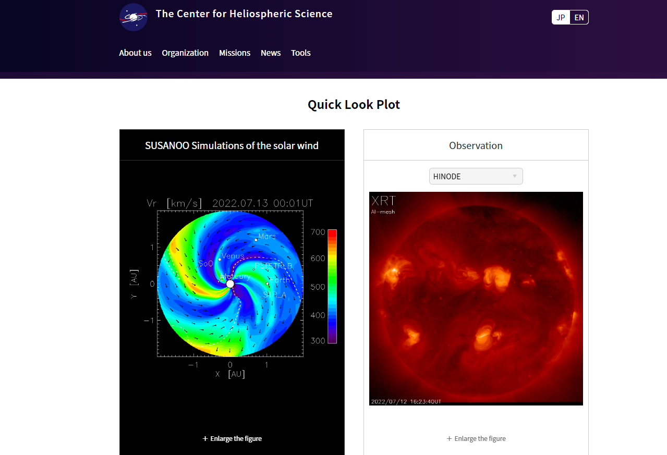
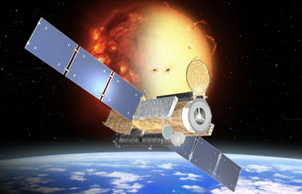
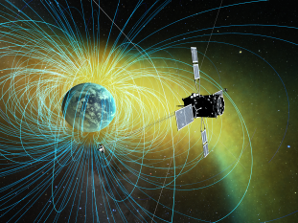
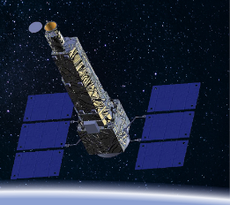
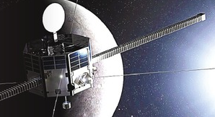

Center for Heliospheric Science
ISEE, Nagoya University
Center for Heliospheric Science
NAOJ
Hinode / Solar-C(EUVST)
ISAS/JAXA
ERG , BepiColombo-Mio
ERG
(Arase)
Hinode
Mio
Solar-C_EUVST
Ground-based observations
Simulations
Data
Integrated data analysis tool
Inter-university/institutions
cooperation
Science Community
-Data Archive w/ standard format
-Tools (SSW/SPEDAS)
-Science Operation Plan
-Tutorial/Training Course
-International Heliophysics Data
Environment Alliance

Slide 6
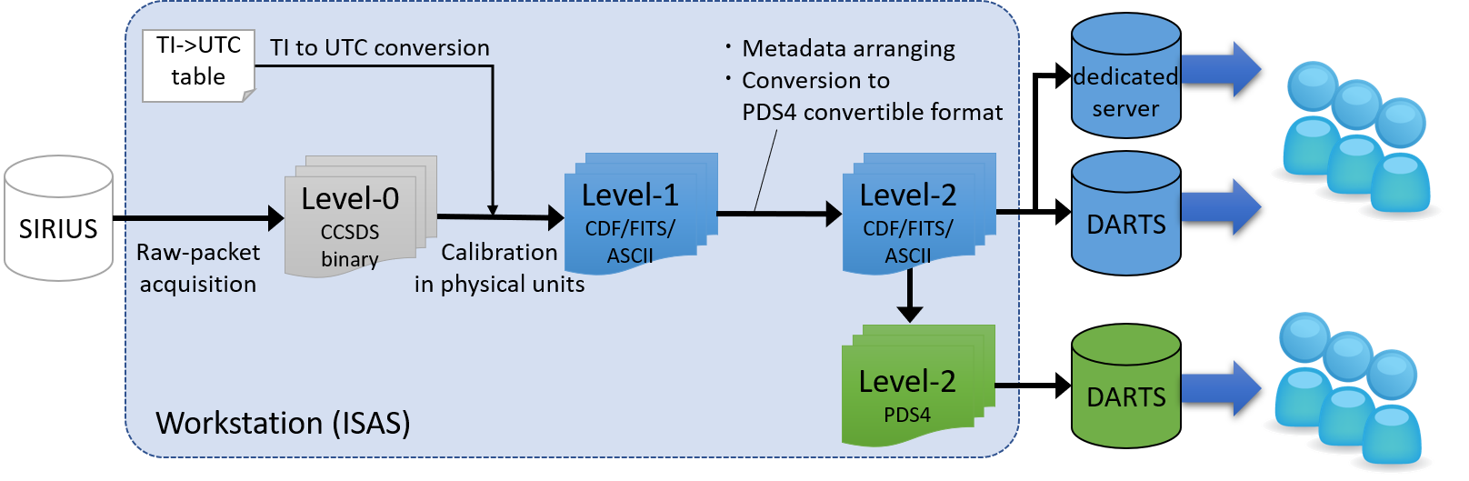
Data Pipeline
PI team
Mio Science Center
Level-2 data will be opened to the public 6-months after the observation.
Level-2 pre
CDF
(selected instruments)
PSA
(ESA)
Level | Contents | Scope | File format
Level-0 | Raw-telemetry | Internal | CCSDS-Binary
Level-1 | Calibrated data in physical units | Internal | CDF, FITS, ASCII
Level-2pre | Calibrated data in physical units with minimum meta data | Internal | CDF, PDS4
Level-2 | Calibrated data in physical units with appropriate metadata | Public | CDF, FITS, ASCII PDS4
Level-3 | Processed data by combining multiple data from different instruments | Public | CDF, FITS, ASCII PDS4

Slide 7
Data Handling Schedule
Nominal
operation start
End of
Nom. Operation
1 yr
Mission
termination
2 yrs
Mercury orbit
insertion
0.5 yrs
FY2022
FY2023
FY2024
FY2025
FY2026
FY2027
FY2029
Science data design and production
Pipeline scripts
<Design/Implementation>
Pipeline scripts
<Automation/Maintenance>
Science data production (L2)
Data calibration / update
Design/Production
PDS4 Production
Pre-science data release (L2pre)
Science data release (L2)
PDS4 Design/Production
Release (project only)
Release
Science data production (L3)
Data calibration / update
Design
Production
PDS4 Design/Production
Science data archiving
Science data release (L3)
Release
Data sharing scheme (discussion)
Versioning policy (discussion)
Versioning
DOI
Archiving
Document (L2)
Archiving
Document (L3)
Analysis tool/web page
Integrated heliophysics data analysis tool
Conjunction Event Finder
Load procedure
(IDL SPEDAS/PySPEDAS)
Quick Look
Operation history
SPICE
Webpage
Webpage maintenance
Data analysis workshop (domestic)
Data analysis workshop (international)

Slide 8
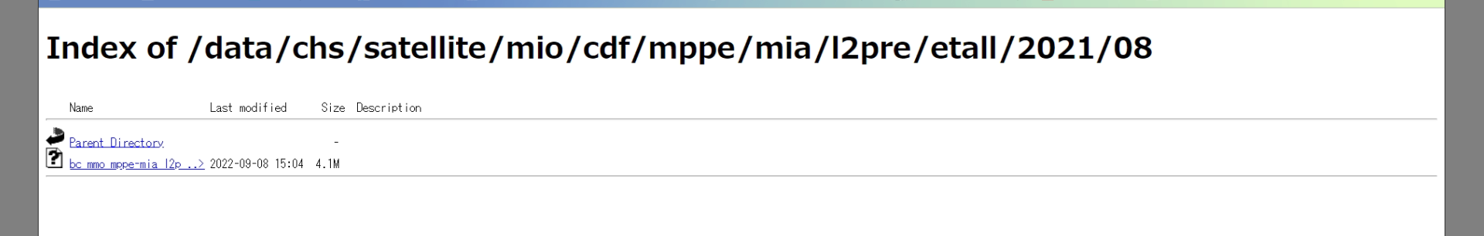
Example of Level-2 pre CDF file (MPPE/MIA)
■Current plan for Level-2 pre CDF files:
MIA, MEA, PWI (OFA-spectrum), and SPM
made to be compliant with the PDS4 compatible CDF-A specifications:
  Carry the ISTP/IACG compliant metadata
  No compression applied for either of file and variable.
  Includes some metadata as appear in some MAVEN files.
■Repository address at science center webpage (MPPE/MIA):
https://chs.isee.nagoya-u.ac.jp/data/chs/satellite/mio/cdf/mppe/mia/l2pre/etall/yyyy/mm
■File name (MPPE/MIA):
bc_mmo_mppe-mia_l2p_l_et_all_20210809_r00_v00_00.cdf

Slide 9
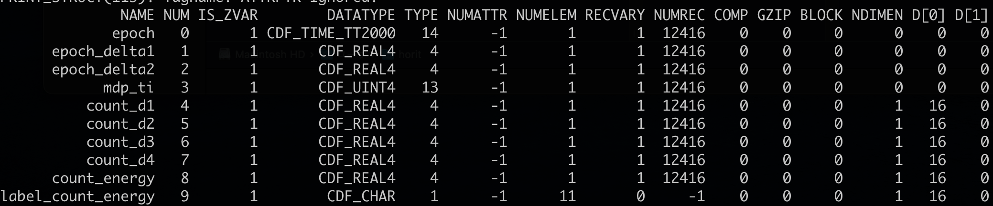
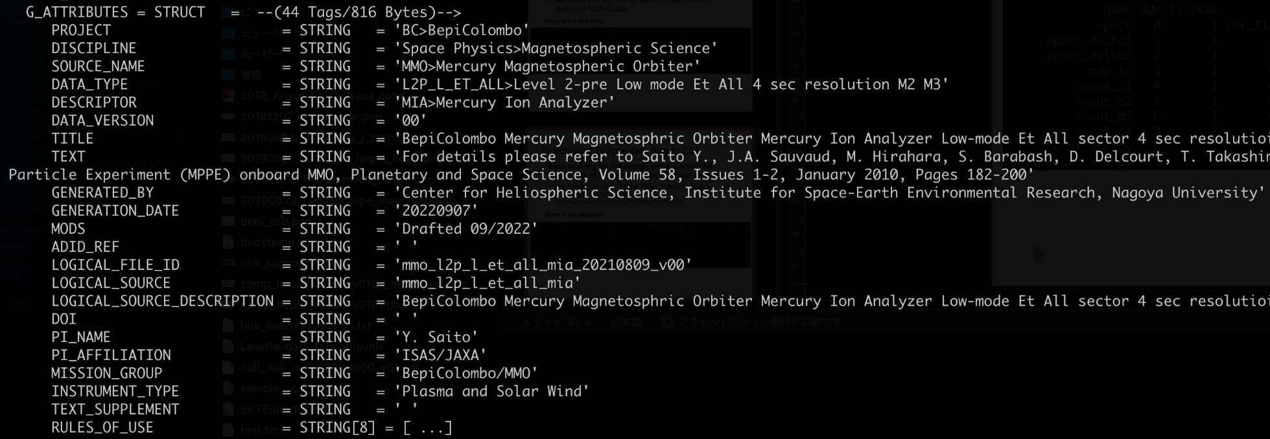
Example of Level-2 pre CDF file (MPPE/MIA)
Dump of the data block
Dump of the metadata block

Slide 10
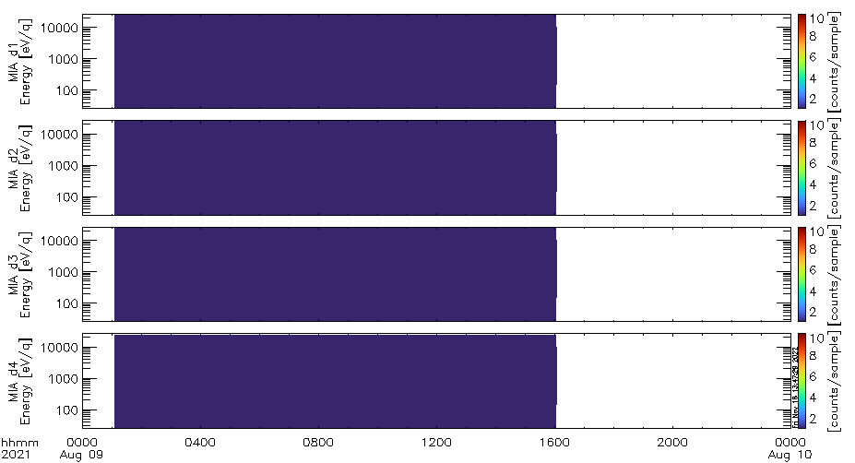
Example of Mio/SPEDAS-plug in
MIO-SC plugin (SPEDAS)
Data analysis
Load the dataset from MIO-SC data repository and store into the local data repository.
(e.g., …/data/chs/satellite/mio/cdf/mppe/mia/l2pre/etall)
Read the dataset and store into “tplot variables”.
Set the options for tplot variables.
(e.g., axis ranges, units, titles, etc.)
Display the necessary information to the users.
(e.g., rule of the road, contact information, the link for data DOI or the detailed information)
Plot the tplot variables.
10

Slide 11
Product Plan
■ Science Data Files:
(before insertion)
- L2Pre data files : Pre-Science Data files (CDF) for MIA, MEA, PWI, and SPM.
First CDF data files will be released via the science center webpage
(after insertion)
- L2 data files: Science Data files (CDF)
■ Data Analysis Environment:
Mio Plugin software for SPEDAS/PySPEDAS

Slide 12
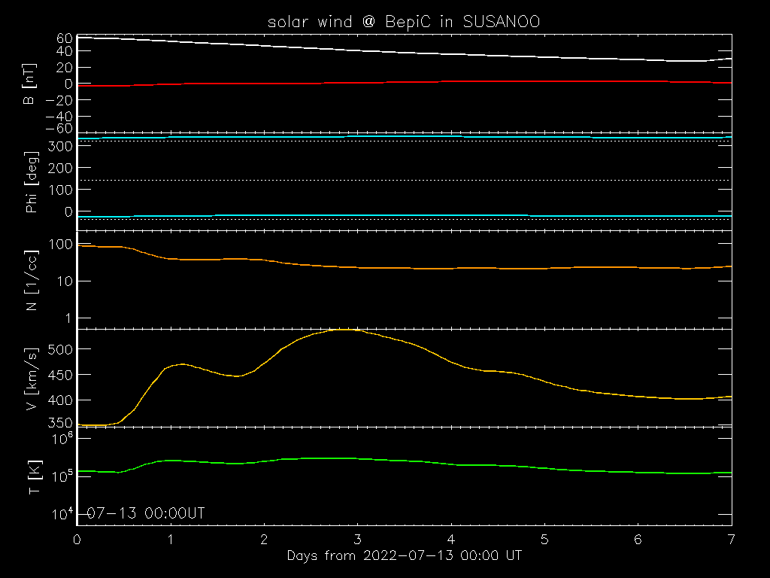
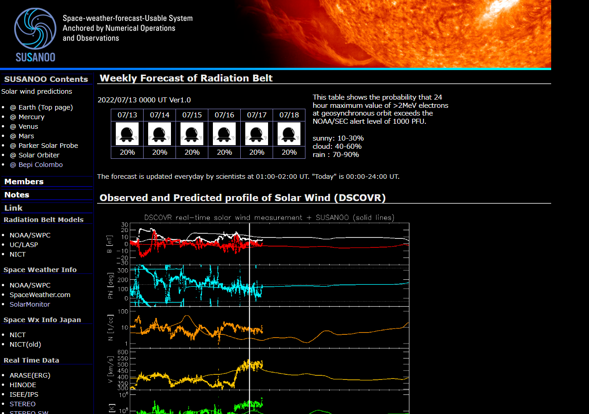
Simulation of Heliosphere: SUSANOO Archived Data (SAD)
Simulated solar wind at BepiColombo
-CDF files of SAD at different locations
have been archived and will be opened
to the public via the Science Center.
-SPEDAS software is available to load and
plot the data files, which are easily
compared with other data sets.

Slide 13
Summary
Launch of Mio Science Center
- Tasks of the science center in this year
- Development of Level-2 Pre CDF files for the science data
- Development and release of the integrated data analysis software (SPEDAS Plug-in)
Currently, the positions on the assistant professors who work at the Science Center, Nagoya University, are opened. If you are interested in, please contact to us.

