Slide 1
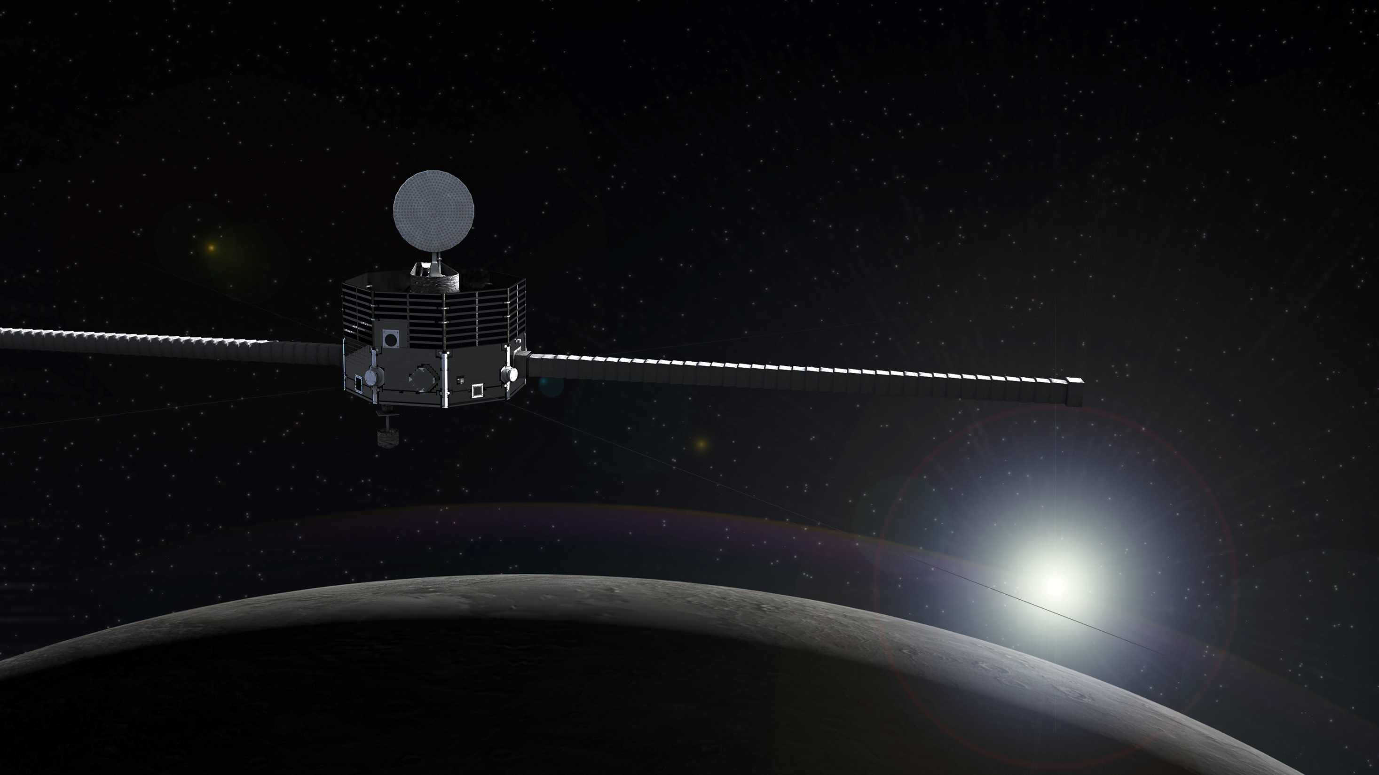




Mio operations report
BepiColombo online SWT (30 September 2021)
Go Murakami
BepiColombo project
Japan Aerospace Exploration Agency (JAXA)
Notes:
-First of all, I’m so happy I can come here and I can report this, because it means no delay of launch and successful operations
-Today I report the overview, current status, and future operations plans of BepiColombo mission

Slide 2
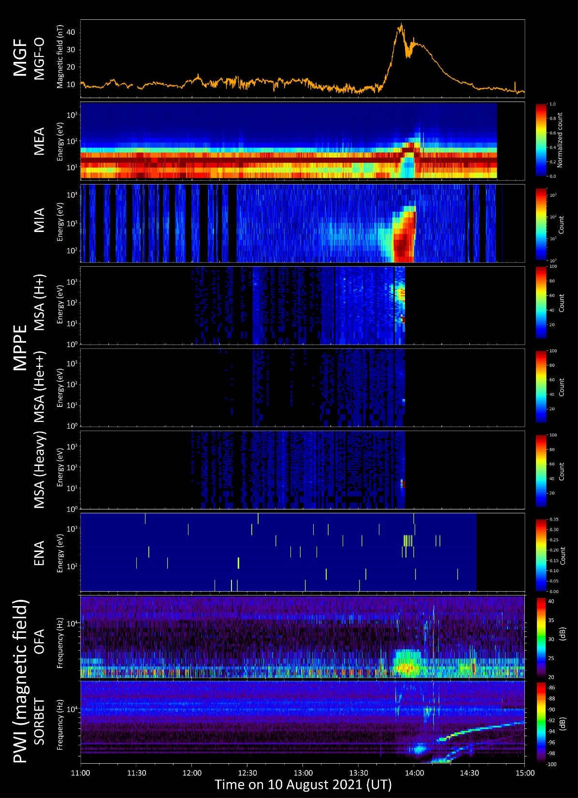
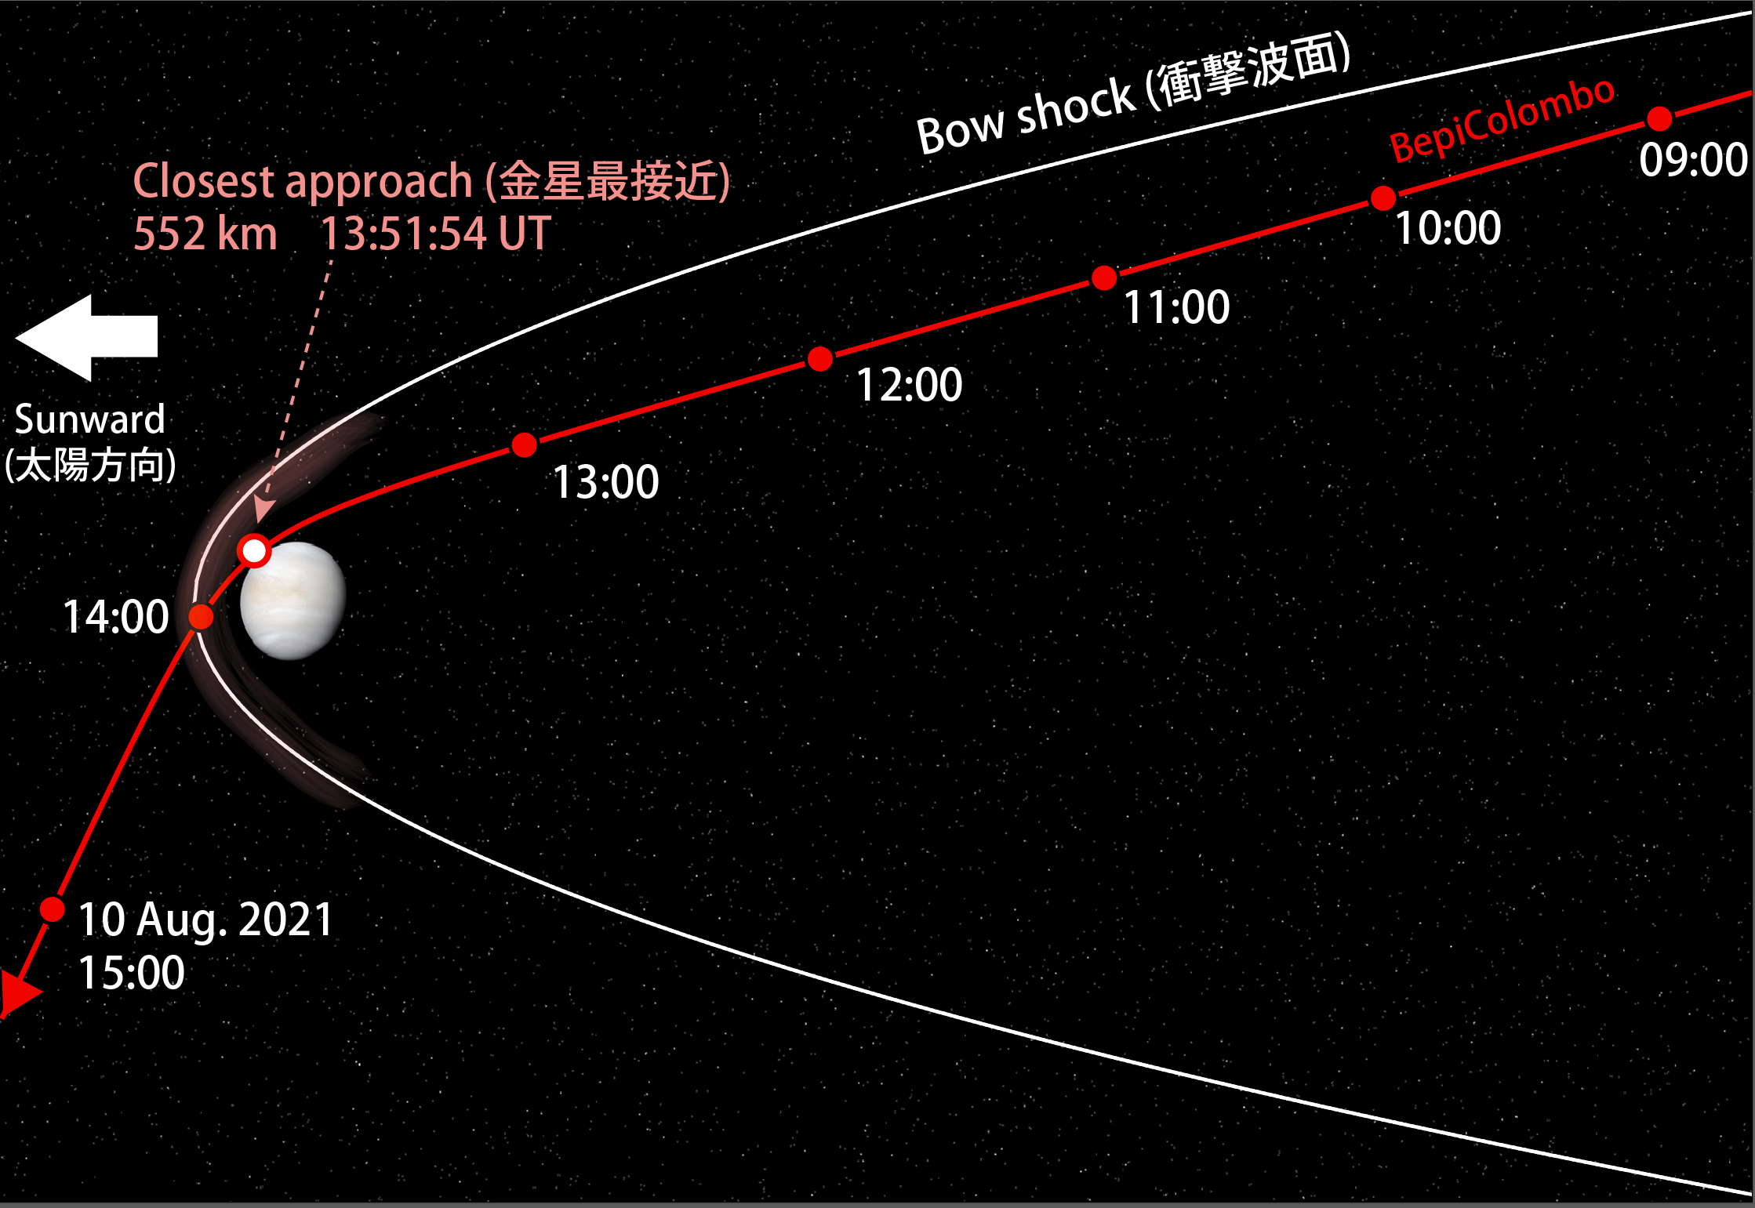
Uncalibrated
Closest approach
Magnetic field
Mio observation summary of Venus swing-by #2
-> It will be published tomorrow on JAXA/ISAS web
Electron
Ion
Proton
He++
Heavy ions
Neutral particles
Plasma wave (B-field)
Plasma wave (B-field)

Slide 3
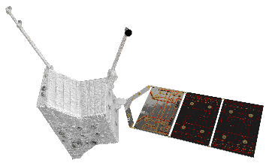


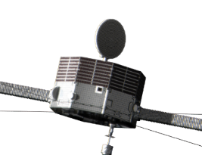
MSB #1: operations overview
Instruments
Mercury flyby geometry
Instrument |  | Observation & data modes
MPPE | ENA | High
 | HEP-ele | Normal, only L
 | HEP-ion | OFF
 | MSA | Normal, only L
 | MIA | Normal, only L
 | MEA | Normal, only L
PWI | EWO | Only EWO-B, L & M
 | SORBET | Normal, L & M
 | Others | OFF
MGF | MGF-I | Normal, L & M
 | MGF-O | Normal, only L
MSASI |  | OFF
MDM |  | Normal, only L
Same as 2nd Venus flyby
Duration: ±24 h
TLM rate: ~8 kbps
Notes:
-In the future, we will perform additional commissioning activities in summer next year, for example high voltage instruments
-And then next milestones are flybys: Earth flyby in April 2020 and soon after Venus flybys
-At each flyby, both spacecraft will perform flyby observations
-So now we are working on the flyby observation plans, especially for Venus flybys
-Anyway, our spacecraft had been on the ground so long long years, but now it’s actually gone to space. So we got a mission now, and it’s time for us.

Slide 4
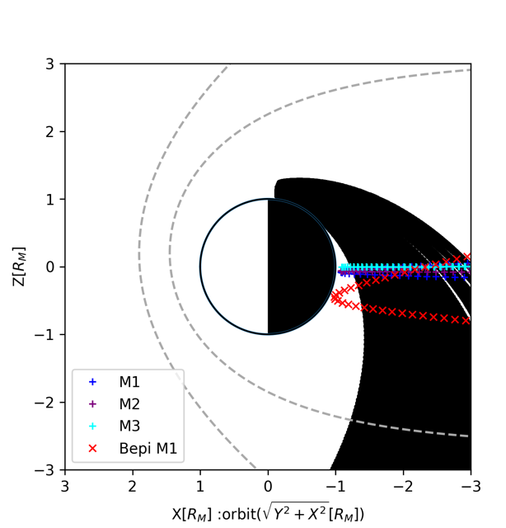
MSB #1: operations overview
Instruments
Mercury flyby geometry
Instrument |  | Observation & data modes
MPPE | ENA | High
 | HEP-ele | Normal, only L
 | HEP-ion | OFF
 | MSA | Normal, only L
 | MIA | Normal, only L
 | MEA | Normal, only L
PWI | EWO | Only EWO-B, L & M
 | SORBET | Normal, L & M
 | Others | OFF
MGF | MGF-I | Normal, L & M
 | MGF-O | Normal, only L
MSASI |  | OFF
MDM |  | Normal, only L
New frontier!
Same as 2nd Venus flyby
Duration: ±24 h
TLM rate: ~8 kbps
Courtesy of Sae Aizawa
Notes:
-In the future, we will perform additional commissioning activities in summer next year, for example high voltage instruments
-And then next milestones are flybys: Earth flyby in April 2020 and soon after Venus flybys
-At each flyby, both spacecraft will perform flyby observations
-So now we are working on the flyby observation plans, especially for Venus flybys
-Anyway, our spacecraft had been on the ground so long long years, but now it’s actually gone to space. So we got a mission now, and it’s time for us.

Slide 5
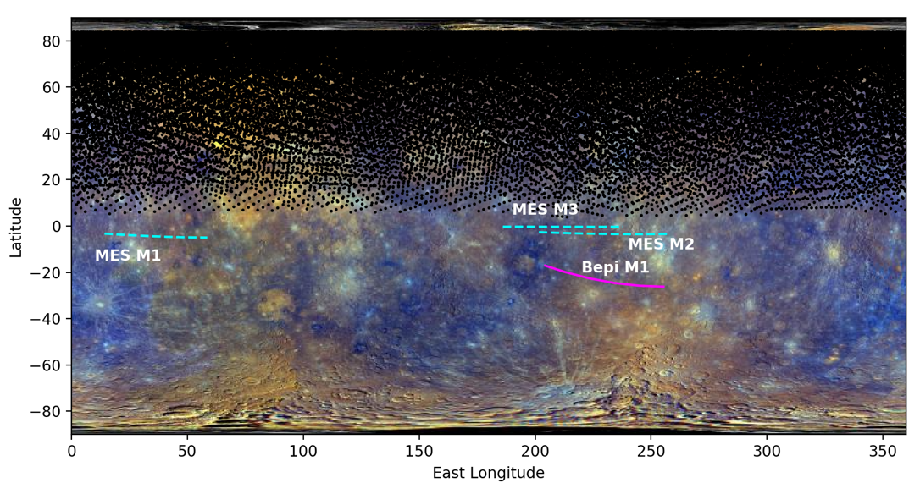
MSB #1: operations overview
Instruments
Mercury flyby geometry
Instrument |  | Observation & data modes
MPPE | ENA | High
 | HEP-ele | Normal, only L
 | HEP-ion | OFF
 | MSA | Normal, only L
 | MIA | Normal, only L
 | MEA | Normal, only L
PWI | EWO | Only EWO-B, L & M
 | SORBET | Normal, L & M
 | Others | OFF
MGF | MGF-I | Normal, L & M
 | MGF-O | Normal, only L
MSASI |  | OFF
MDM |  | Normal, only L
Closest approach ever in southern hemisphere!
Same as 2nd Venus flyby
Courtesy of Sae Aizawa
Duration: ±24 h
TLM rate: ~8 kbps
Notes:
-In the future, we will perform additional commissioning activities in summer next year, for example high voltage instruments
-And then next milestones are flybys: Earth flyby in April 2020 and soon after Venus flybys
-At each flyby, both spacecraft will perform flyby observations
-So now we are working on the flyby observation plans, especially for Venus flybys
-Anyway, our spacecraft had been on the ground so long long years, but now it’s actually gone to space. So we got a mission now, and it’s time for us.

Slide 6
Observation timeline
Event | Time (UT)
Mio ON | 2021/09/30T09:00:00
WOL #1 | 2021/09/30T23:34:42
HV ON | 2021/10/01T00:04:42
OBS A (~8.6 h) | 2021/10/01T02:31:58
HV OFF | 2021/10/01T11:10:16
WOL #2 | 2021/10/01T11:34:42
HV ON | 2021/10/01T12:04:42
OBS B (~3.1 h) | 2021/10/01T14:31:40
HV OFF | 2021/10/01T17:40:16
WOL #3 | 2021/10/01T18:04:42
HV ON | 2021/10/01T18:34:42
OBS C (~0.3 h) | 2021/10/01T21:01:40
HV OFF | 2021/10/01T21:15:16
WOL #4 | 2021/10/01T21:39:42
HV ON | 2021/10/01T22:09:42
OBS D (~0.6 h) | 2021/10/02T00:36:40
HV OFF | 2021/10/02T01:10:16
WOL #5 | 2021/10/02T01:34:42
HV ON | 2021/10/02T02:04:42
OBS E (~6.6 h) | 2021/10/02T04:31:40
Now here: we got a problem in Mio ON sequence and under investigation
10/2 02:00
Bow shock
WOL#5
10/2 01:00
OBS D
10/2 00:00
Magnetopause
OBS D except for MSA
10/1 23:00
10/1 22:00
# MIA/MEA/HEP-e/ENA are ready by 22:53:34 (but in TLM MODE 10, 4 kbps for science)
WOL#4
OBS C
10/1 21:00

Slide 7
Observation timeline
Event | Time (UT)
HV OFF | 2021/10/02T11:10:16
WOL #6 | 2021/10/02T11:34:42
HV ON | 2021/10/02T12:04:42
OBS F (~8.3 h) | 2021/10/02T14:31:40
HV OFF | 2021/10/02T22:49:30
SI OFF | 2021/10/02T23:14:04
Mio OFF | 2021/10/02T23:39:20
WOL #7 | 2021/10/02T23:34:42
10/2 02:00
Bow shock
WOL#5
10/2 01:00
OBS D
10/2 00:00
Magnetopause
OBS D except for MSA
10/1 23:00
10/1 22:00
WOL#4
OBS C
10/1 21:00

Slide 8
MIO Operation schedule for 2021/June - Oct
2021.6.24
 | Checkout/maintenance
 | 17-18 June | Cruise C/O#5, BAT charging | Completed
 | 22-24 June | MIA, MSA, HEP program update and function check | Completed
 | 28 June | VSB2 dry-run with new MDP middleware | Completed
 | December? | Cruise C/O#6
 |  | MSA HV ramp with OCL command investigation (BC_SC-104) | Pending
 |  | MSA mission data generation investigation (BC_SC-76) | Pending
 |  | MSA sweep voltage investigation (TBD) | Pending (with cruise C/O in Nov 2021?)
 | Science observation
 | 12-16 June | Cruise observation solar-wind mode (MEA1, HEP-e) | Completed
 | 19-21 June 25-27 June 29 June – 2 Jul | Cruise observation solar-wind mode (MEA1, HEP-e) + MGF | Completed
a-1 | 5 – 15 Jul | Cruise observation solar-wind mode (MEA1, HEP-e) + MGF | Completed
a-2 | 19 – 30 Jul |  | Canceled
 | 10 Aug | Venus flyby#2 | Completed
b | 14 – 19 Aug | Cruise observation solar-wind mode (MEA1, HEP-e) + MGF | Completed
c | 7 – 15 Sep | Cruise observation solar-wind mode (MEA1, HEP-e) + MGF | Completed
 | 2 Oct | Mercury Flyby#1
d | 7 – 8 Oct | Cruise observation solar-wind mode (MEA1, HEP-e) + MGF
e | 16 -28 Oct | Cruise observation solar-wind mode (MEA1, HEP-e) + MGF

Slide 9
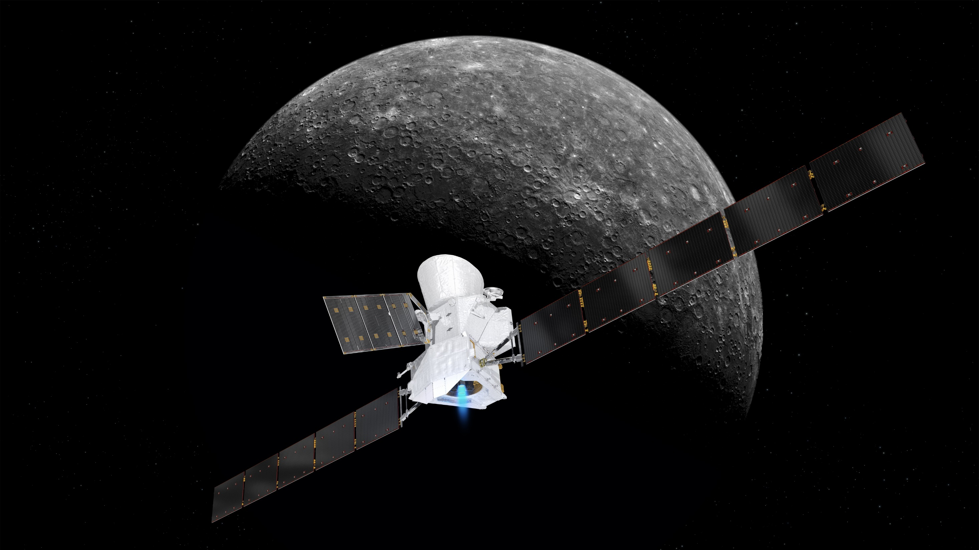


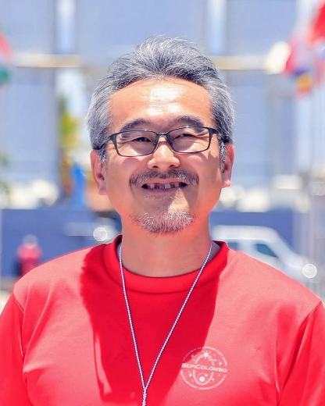


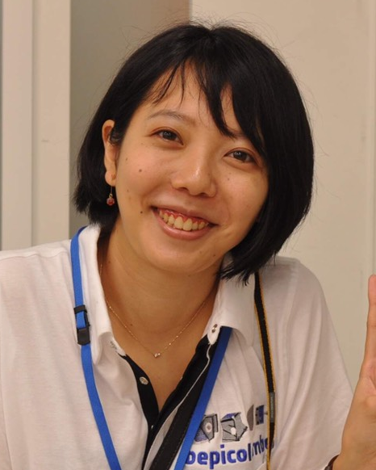
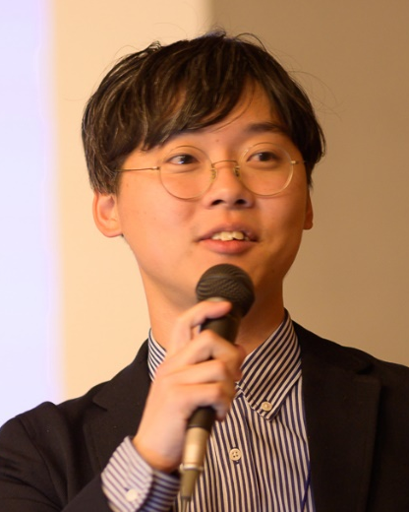
2021年10月1日（金）20:00～21:00
BepiColombo「みお」がついに水星へ接近！
～第1回水星スイングバイ前夜祭トークライブ～
水星磁気圏探査機「みお」を含むBepiColombo水星探査機は、2021年10月2日午前8時34分頃（日本時間）に水星の高度200 kmまで接近し1回目の水星スイングバイを実施します。
そこで、その前夜にプロジェクトメンバおよび理学・工学の専門家をゲストに招き、ミッション概要や今回の水星スイングバイの計画についてご紹介します！
＜主なトーク内容＞
・ミッション全体概要と最新状況
・水星スイングバイの意義、計画
・運用室より中継 ほか
みお運用室より
中継を交えて
YouTubeライブ配信
（予定）
JAXA ベピコロンボプロジェクト
プロジェクトマネージャ
小川 博之
JAXA ベピコロンボプロジェクト
プロジェクトサイエンティスト
村上 豪
JAXA 宇宙科学研究所
副所長
藤本 正樹
Institute of Astrophysics and Planetology (フランス), 博士研究員
相澤 紗絵
JAXA 宇宙科学研究所
宇宙機応用工学研究系 助教
尾崎 直哉
jaxasgm – JAXA相模原チャンネル にて配信

Slide 10
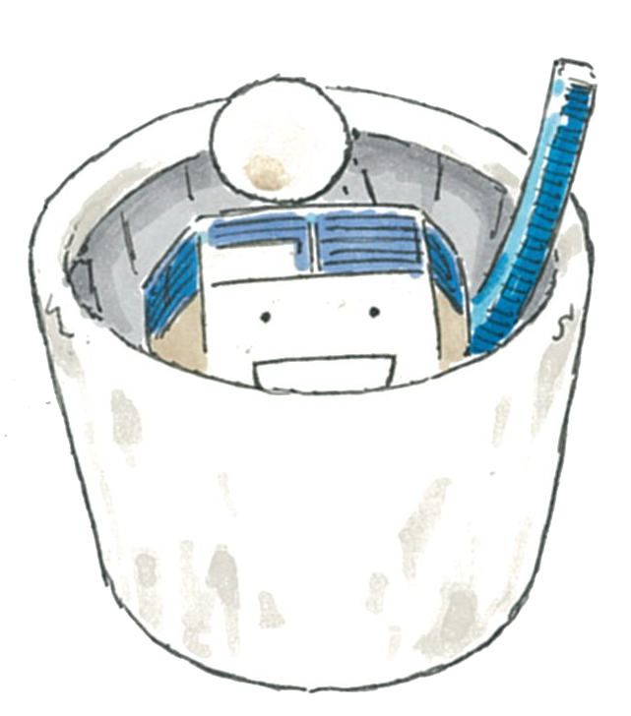
Thank you!
Stay safe!
Illustration by Masayuki Ishikawa

