Slide 1
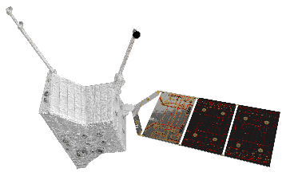
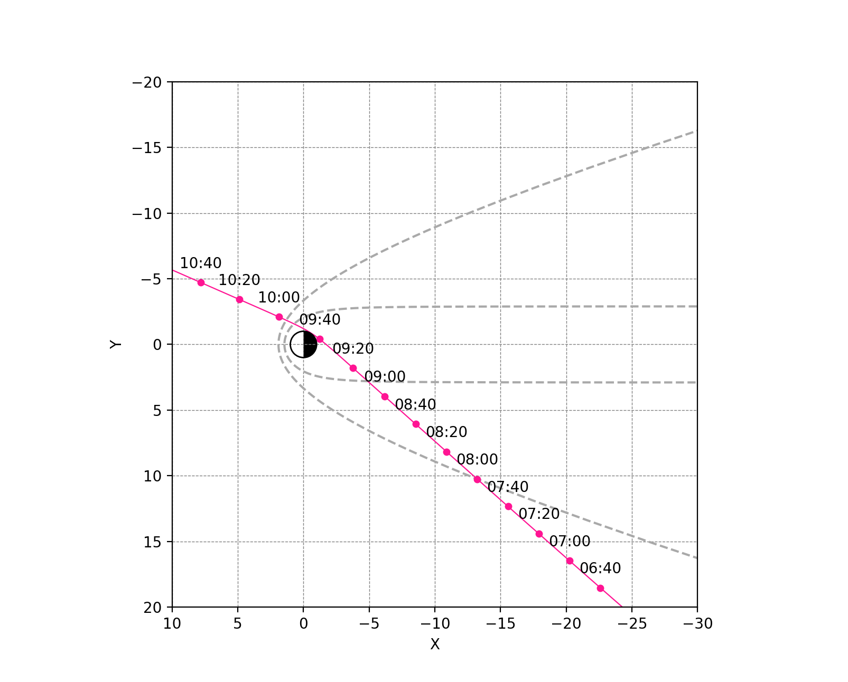
2nd Mercury flyby observation
2nd Mercury flyby geometry
Instrument list: same as 1st Mercury flyby
Instrument |  | Observation & data modes
MPPE | ENA | High
 | HEP-ele | Normal, only L
 | HEP-ion | OFF
 | MSA | Normal, only L
 | MIA | Normal, only L
 | MEA | Normal, only L
PWI | EWO | Only EWO-B, L & M
 | SORBET | Normal, L & M
 | Others | OFF
MGF | MGF-I | Normal, L & M
 | MGF-O | Normal, only L
MSASI |  | OFF
MDM |  | Normal, only L
Closest approach at 200 km
09:44:22 UTC
Duration: -26.5h ～ +32.5h
WOL: avoid CA-2.5h to CA+0.5h if possible (HV start 10 min after WOL, taking 1.7h for HV ramp)
TLM rate: ~8 kbps (7 kbps for science)
Pointing: direct open FoV to Mercury if possible
Notes:
-In the future, we will perform additional commissioning activities in summer next year, for example high voltage instruments
-And then next milestones are flybys: Earth flyby in April 2020 and soon after Venus flybys
-At each flyby, both spacecraft will perform flyby observations
-So now we are working on the flyby observation plans, especially for Venus flybys
-Anyway, our spacecraft had been on the ground so long long years, but now it’s actually gone to space. So we got a mission now, and it’s time for us.

Slide 2
-Full observation will start BEFORE in-bound magnetopause crossing
-> Boundary crossing detections w/o data gap!
-Similar trajectory to MSB#1
-> Best chance to comparison between #1 and #2!
Closest approach
09:44:22 UTC
Full OBS
7 kbps
WOL#4
OBS w/o MSA
Full OBS
08:56
OBS w/o MSA
4 kbps
07:58
WOL#4

