Slide 1
The K factor= Mean_energy/Uan are given in files:
-Mea2_FM_Properties_100eV_19Apr_2012.txt
-Mea1_FM_Properties_100eV_03Jul_2012.txt
This variable is called k (penultimate column)
k
0 1.000 0 -1.00E+03 161.6 1.2 5.08 8.68 0.104
0 1.000 1 5.11E-06 146.6 0.9 5.17 8.59 0.122
0 1.000 2 5.20E-06 122.8 0.8 5.17 8.50 0.127
0 1.000 3 5.62E-06 101.9 0.7 5.08 8.49 0.016
0 1.000 4 6.16E-06 78.9 0.4 5.35 8.52 0.199
0 1.000 5 6.41E-06 57.2 -0.2 5.41 8.61 0.118
0 1.000 6 6.49E-06 34.0 -0.7 5.44 8.71 0.132
0 1.000 7 5.59E-06 12.3 -0.8 5.79 8.83 0.124

Slide 2
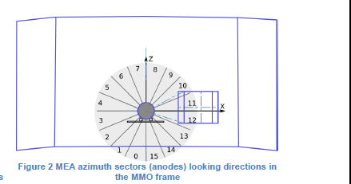
+Z
Sectors 7 and 8 of the MCP measure the particles with velocity along the –Z axis

